Slide 1
Transmission Media

Slide 2
Overview
Guided - wire
Unguided - wireless
Characteristics and quality determined by medium and signal
For guided, the medium is more important
For unguided, the bandwidth produced by the antenna is more important
Key concerns are data rate and distance

Slide 3
Design Factors
Bandwidth
  Higher bandwidth gives higher data rate
Transmission impairments
  Attenuation
Interference
Number of receivers
  In guided media
  More receivers (multi-point) introduce more attenuation

Slide 4
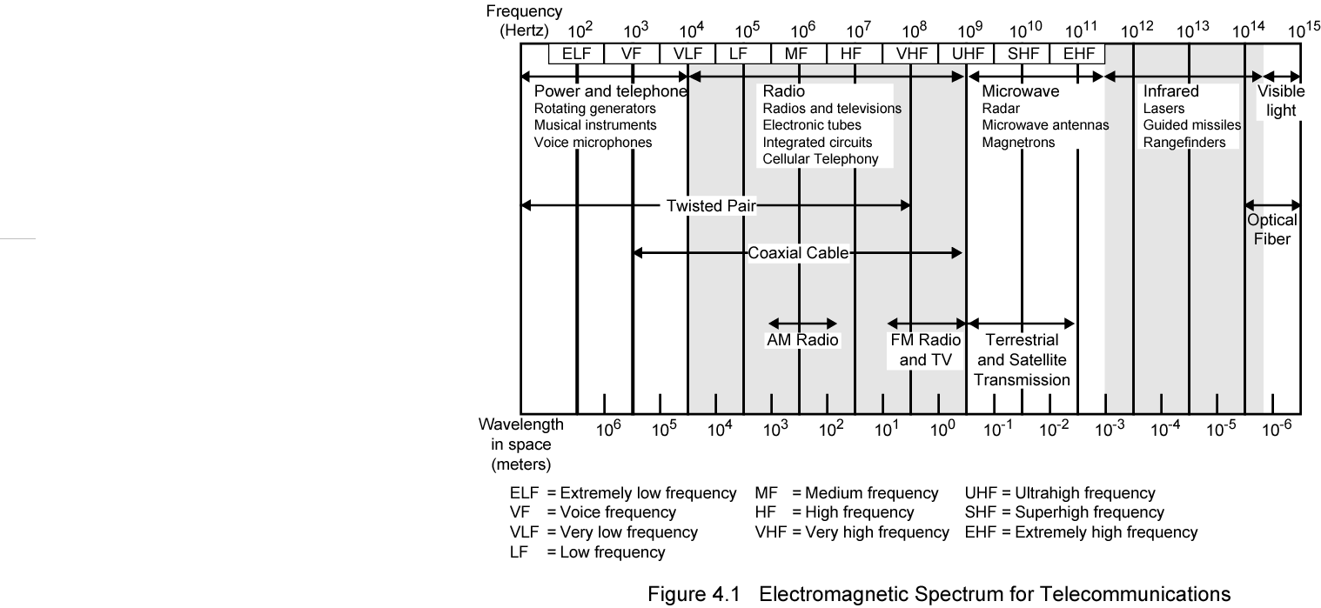
Electromagnetic Spectrum

Slide 5
Transmission Impairments
signal received may differ from signal transmitted causing:
  analog - degradation of signal quality
  digital - bit errors
most significant impairments are
  attenuation and attenuation distortion
  delay distortion
  noise
Notes:
With any communications system, the signal that is received may differ from the signal that is transmitted due to various transmission impairments. For analog signals, these impairments can degrade the signal quality. For digital signals, bit errors may be introduced, such that a binary 1 is transformed into a binary 0 or vice versa.

Slide 6
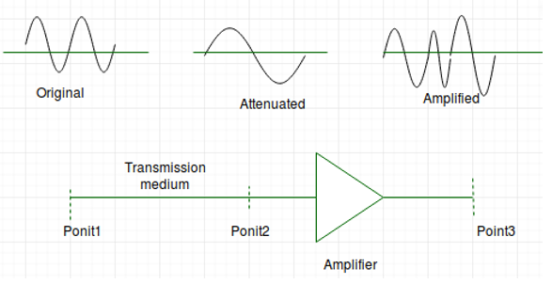
Attenuation
where signal strength falls off with distance
depends on medium
received signal strength must be:
  strong enough to be detected
  sufficiently higher than noise to receive without error
so increase strength using amplifiers/repeaters
is also an increasing function of frequency
so equalize attenuation across band of frequencies used
  eg. using loading coils or amplifiers
Notes:
Attenuation is where the strength of a signal falls off with distance over any transmission medium. For guided media, this is generally exponential and thus is typically expressed as a constant number of decibels per unit distance. For unguided media, attenuation is a more complex function of distance and the makeup of the atmosphere. See Stallings DCC8e Figure 3.11 on previous slide for illustration of attenuation.
Attenuation introduces three considerations for the transmission engineer. First, a received signal must have sufficient strength so that the electronic circuitry in the receiver can detect the signal. Second, the signal must maintain a level sufficiently higher than noise to be received without error. Third, attenuation varies with frequency. The first and second problems are dealt with by attention to signal strength and the use of amplifiers or repeaters. The third problem is particularly noticeable for analog signals. To overcome this problem, techniques are available for equalizing attenuation across a band of frequencies. This is commonly done for voice-grade telephone lines by using loading coils that change the electrical properties of the line; the result is to smooth out attenuation effects. Another approach is to use amplifiers that amplify high frequencies more than lower frequencies.

Slide 7
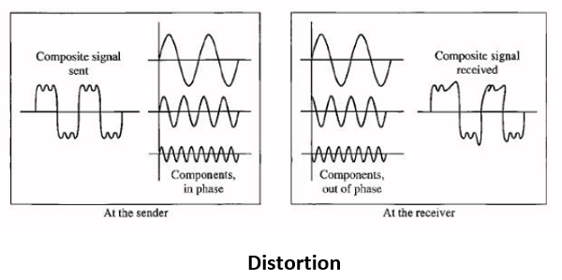
Delay Distortion
only occurs in guided media
propagation velocity varies with frequency
hence various frequency components arrive at different times
particularly critical for digital data
since parts of one bit spill over into others
causing intersymbol interference
Notes:
Delay distortion occurs because the velocity of propagation of a signal through a guided medium varies with frequency. For a bandlimited signal, the velocity tends to be highest near the center frequency and fall off toward the two edges of the band. Thus various frequency components of a signal will arrive at the receiver at different times, resulting in phase shifts between the different frequencies. Delay distortion is particularly critical for digital data, because some of the signal components of one bit position will spill over into other bit positions, causing intersymbol interference. This is a major limitation to maximum bit rate over a transmission channel.

Slide 8
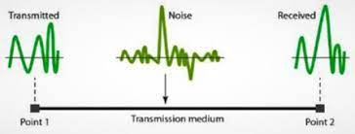
Noise
additional signals inserted between transmitter and receiver
thermal
  due to thermal agitation of electrons
  uniformly distributed
  white noise
intermodulation
  signals that are the sum and difference of original frequencies sharing a medium
Notes:
For any data transmission event, the received signal will consist of the transmitted signal, modified by the various distortions imposed by the transmission system, plus additional unwanted signasl, referred to as noise, that are inserted somewhere between transmission and reception. Noise is a major limiting factor in communications system performance. Noise may be divided into four categories.
Thermal noise is due to thermal agitation of electrons. It is present in all electronic devices and transmission media and is a function of temperature. Thermal noise is uniformly distributed across the bandwidths typically used in communications systems and hence is often referred to as white noise. Thermal noise cannot be eliminated and therefore places an upper bound on communications system performance, and. is particularly significant for satellite communication.
When signals at different frequencies share the same transmission medium, the result may be intermodulation noise. The effect of intermodulation noise is to produce signals at a frequency that is the sum or difference of the two original frequencies or multiples of those frequencies, thus possibly interfering with services at these frequencies. It is produced by nonlinearities in the transmitter, receiver, and/or intervening transmission medium.

Slide 9
Noise
crosstalk
  a signal from one line is picked up by another
impulse
  irregular pulses or spikes
    eg. external electromagnetic interference
  short duration
  high amplitude
  a minor annoyance for analog signals
  but a major source of error in digital data
    a noise spike could corrupt many bits
Notes:
Crosstalk is an unwanted coupling between signal paths. It can occur by electrical coupling between nearby twisted pairs or, rarely, coax cable lines carrying multiple signals. It can also occur when microwave antennas pick up unwanted signals; although highly directional antennas are used, microwave energy does spread during propagation. Typically, crosstalk is of the same order of magnitude as, or less than, thermal noise.
Impulse noise is noncontinuous, consisting of irregular pulses or noise spikes of short duration and of relatively high amplitude. It is generated from a variety of causes, including external electromagnetic disturbances, such as lightning, and faults and flaws in the communications system. It is generally only a minor annoyance for analog data. However impulse noise is the primary source of error in digital data communication. For example, a sharp spike of energy of 0.01 s duration would not destroy any voice data but would wash out about 560 bits of data being transmitted at 56 kbps.

Slide 10
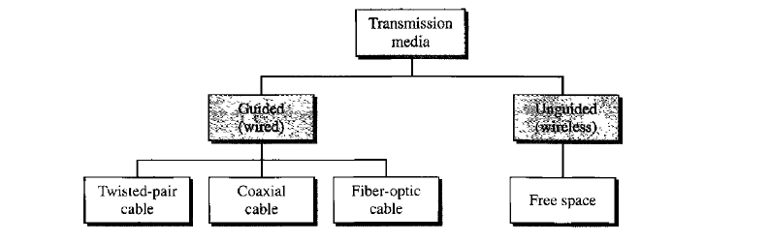
Classes of Transmission Media

Slide 11
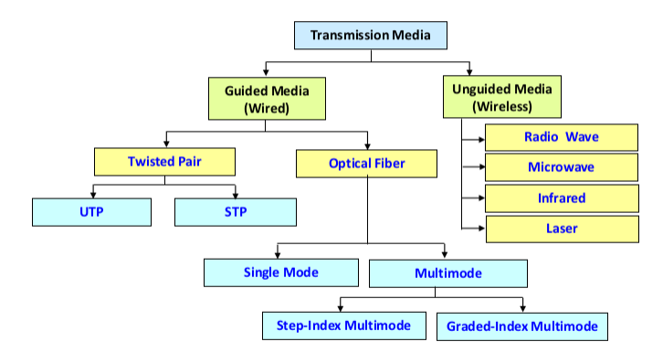
Classes of Transmission Media

Slide 12
Guided Transmission Media
Twisted Pair
Coaxial cable
Optical fiber

Slide 13
Transmission Characteristics of Guided Media
Frequency Range
Typical Attenuation
Typical Delay
Repeater Spacing
Twisted pair (with loading)
0 to 3.5 kHz
0.2 dB/km @ 1 kHz
50 µs/km
2 km
Twisted pairs (multi-pair cables)
0 to 1 MHz
0.7 dB/km @ 1 kHz
5 µs/km
2 km
Coaxial cable
0 to 500 MHz
7 dB/km @ 10 MHz
4 µs/km
1 to 9 km
Optical fiber
186 to 370 THz
0.2 to 0.5 dB/km
5 µs/km
40 km

Slide 14
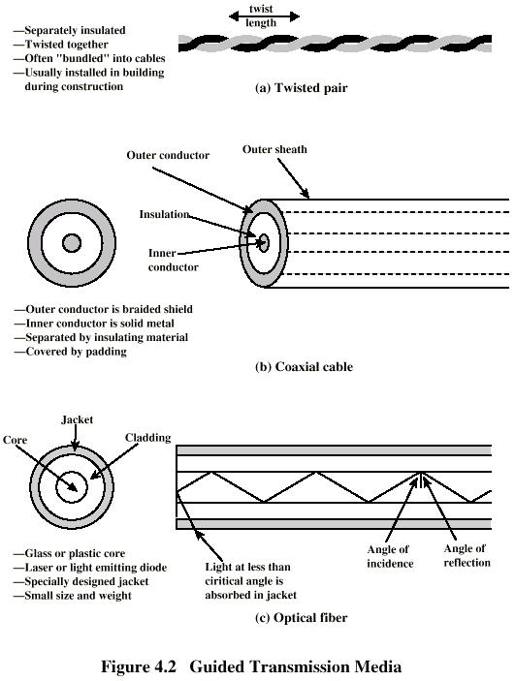
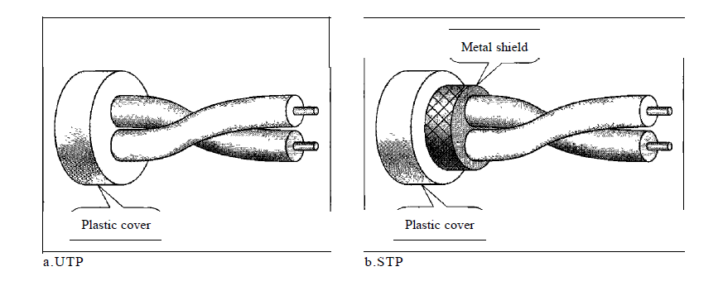
Twisted Pair

Slide 15
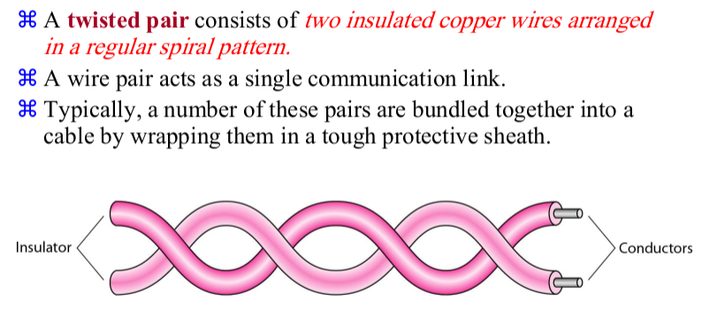
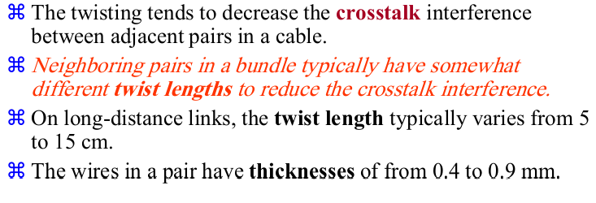
Twisted Pair

Slide 16
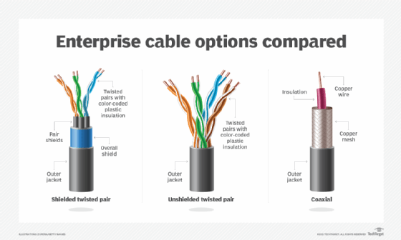
Twisted Pair

Slide 17
Twisted Pair - Applications
Most common medium
Telephone network
  Between house and local exchange (subscriber loop)
Within buildings
  To private branch exchange (PBX)
For local area networks (LAN)
  10Mbps or 100Mbps

Slide 18
Twisted Pair - Pros and Cons
Cheap
Easy to work with
Low data rate
Short range

Slide 19
Twisted Pair - Transmission Characteristics
Analog
  Amplifiers every 5km to 6km
Digital
  Use either analog or digital signals
  repeater every 2km or 3km
Limited distance
Limited bandwidth (1MHz)
Limited data rate (100MHz)
Susceptible to interference and noise

Slide 20
Near End Crosstalk
Coupling of signal from one pair to another
Coupling takes place when transmit signal entering the link couples back to receiving pair
i.e. near transmitted signal is picked up by near receiving pair

Slide 21
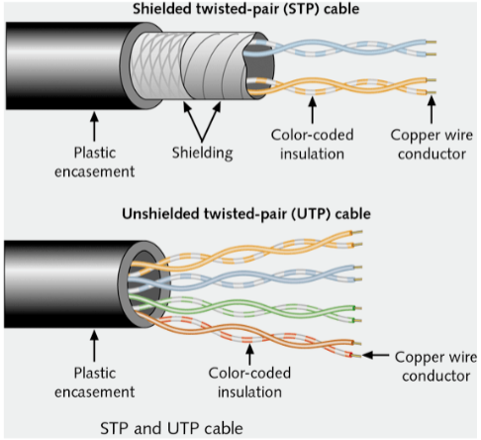
Unshielded and Shielded TP
Unshielded Twisted Pair (UTP)
  Ordinary telephone wire
  Cheapest
  Easiest to install
  Suffers from external EM
  interference
Shielded Twisted Pair (STP)
  Metal braid or sheathing that
  reduces interference
  More expensive
  Harder to handle (thick, heavy)

Slide 22
UTP Categories
Cat 3
  up to 16MHz
  Voice grade found in most offices
  Twist length of 7.5 cm to 10 cm
Cat 4
  up to 20 MHz
Cat 5
  up to 100MHz
  Commonly pre-installed in new office buildings
  Twist length 0.6 cm to 0.85 cm
Cat 5E Data rate : 125Mbps
Cat 6: 200 Mbps
Cat 7: 600 Mbps

Slide 23
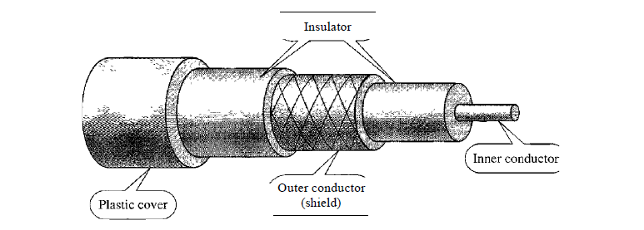
Coaxial Cable

Slide 24
Coaxial Cable Applications
Most versatile medium
Television distribution
  Ariel to TV
  Cable TV
Long distance telephone transmission
  Can carry 10,000 voice calls simultaneously
  Being replaced by fiber optic
Short distance computer systems links
Local area networks

Slide 25
Coaxial Cable - Transmission Characteristics
Analog
  Amplifiers every few km
  Closer if higher frequency
  Up to 500MHz
Digital
  Repeater every 1km
  Closer for higher data rates

Slide 26
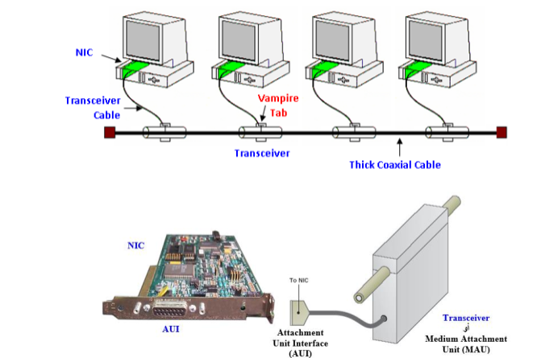
Coaxial standards - 10Base5

Slide 27
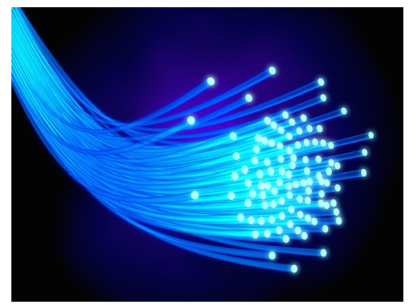
Optical Fiber

Slide 28
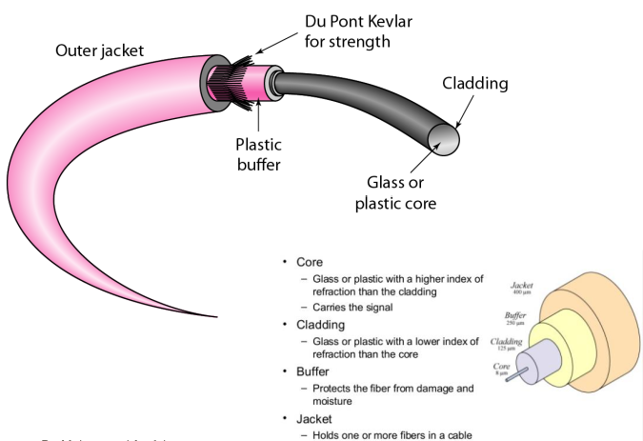
Optical Fiber

Slide 29
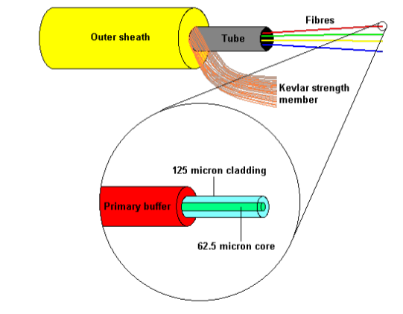
Optical Fiber

Slide 30
Optical Fiber

Slide 31
Optical Fiber - Benefits
Greater capacity
  Data rates of hundreds of Gbps
Smaller size & weight
Lower attenuation
Electromagnetic isolation
Greater repeater spacing
  10s of km at least

Slide 32
Optical Fiber - Applications
Long-haul trunks
Metropolitan trunks
Rural exchange trunks
Subscriber loops
LANs

Slide 33
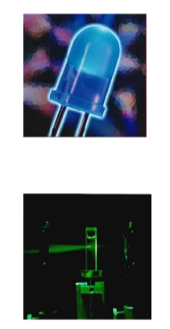
Optical Fiber - Transmission Characteristics
Act as wave guide for 10¹⁴ to 10¹⁵ Hz
  Portions of infrared and visible spectrum
Light Emitting Diode (LED)
  Cheaper
  Wider operating temp range
  Last longer
  Typical Wavelength 850 nm
Injection Laser Diode (ILD)
  More efficient
  Greater data rate
  Typical Wavelength 1300 – 1500 nm
Wavelength Division Multiplexing

Slide 34
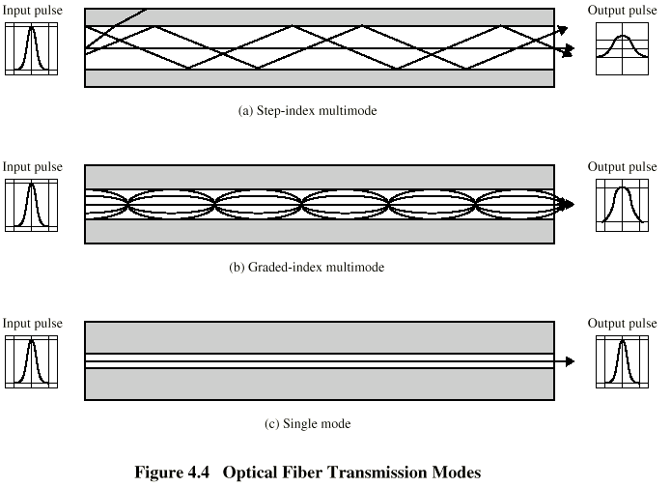
Optical Fiber Transmission Modes

Slide 35
Frequency Utilization for Fiber Applications
Wavelength (in vacuum) range (nm)
Frequency range (THz)
Band label
Fiber type
Application
820 to 900
366 to 333
Multimode
LAN
1280 to 1350
234 to 222
S
Single mode
Various
1528 to 1561
196 to 192
C
Single mode
WDM
1561 to 1620
185 to 192
L
Single mode
WDM

Slide 36
Wireless Transmission Frequencies
2GHz to 40GHz
  Microwave
  Highly directional
  Point to point
  Satellite
30MHz to 1GHz
  Omnidirectional
  Broadcast radio
3 x 10¹¹ to 2 x 10¹⁴
  Infrared
  Local

Slide 37
Antennas
Electrical conductor (or system of..) used to radiate electromagnetic energy or collect electromagnetic energy
Transmission
  Radio frequency energy from transmitter
  Converted to electromagnetic energy
  By antenna
  Radiated into surrounding environment
Reception
  Electromagnetic energy impinging on antenna
  Converted to radio frequency electrical energy
  Fed to receiver
Same antenna often used for both

Slide 38
Radiation Pattern
Power radiated in all directions
Not same performance in all directions
Isotropic antenna is (theoretical) point in space
  Radiates in all directions equally
  Gives spherical radiation pattern

Slide 39
Parabolic Reflective Antenna
Used for terrestrial and satellite microwave
Parabola is locus of point equidistant from a line and a point not on that line
  Fixed point is focus
  Line is directrix
Revolve parabola about axis to get paraboloid
  Cross section parallel to axis gives parabola
  Cross section perpendicular to axis gives circle
Source placed at focus will produce waves reflected from parabola in parallel to axis
  Creates (theoretical) parallel beam of light/sound/radio
On reception, signal is concentrated at focus, where detector is placed

Slide 40
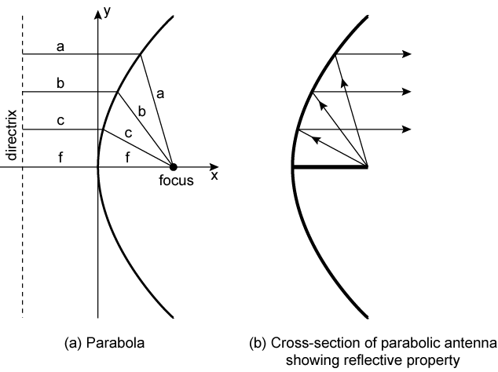
Parabolic Reflective Antenna

Slide 41
Terrestrial Microwave
Parabolic dish
Focused beam
Line of sight
Long haul telecommunications
Higher frequencies give higher data rates

Slide 42
Satellite Microwave
Satellite is relay station
Satellite receives on one frequency, amplifies or repeats signal and transmits on another frequency
Requires geo-stationary orbit
  Height of 35,784km
Television
Long distance telephone
Private business networks

Slide 43
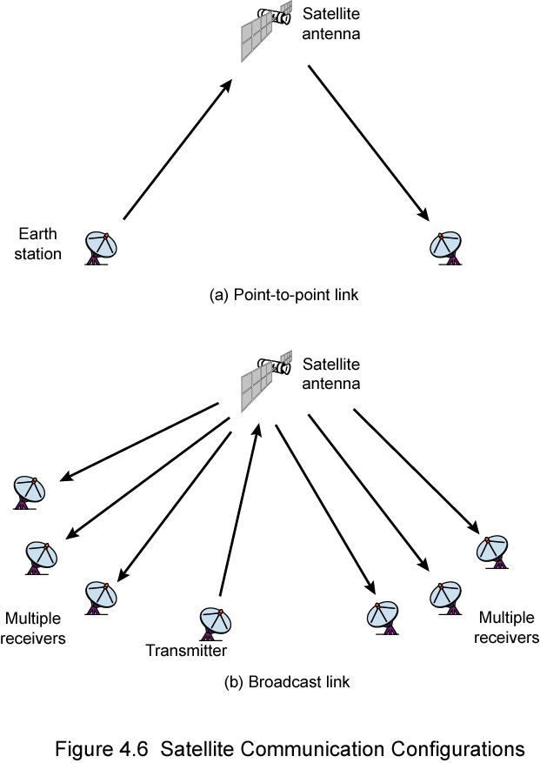
Satellite Point to Point Link

Slide 44
Satellite Broadcast Link

Slide 45
Broadcast Radio
Omnidirectional
FM radio
UHF and VHF television
Line of sight
Suffers from multipath interference
  Reflections

Slide 46
Infrared
Modulate noncoherent infrared light
Line of sight (or reflection)
Blocked by walls
e.g. TV remote control, IRD port

Slide 47
Wireless Propagation
Signal travels along three routes
  Ground wave
    Follows contour of earth
    Up to 2MHz
    AM radio
  Sky wave
    Amateur radio, BBC world service, Voice of America
    Signal reflected from ionosphere layer of upper atmosphere
    (Actually refracted)
  Line of sight
    Above 30Mhz
    May be further than optical line of sight due to refraction
    More later…

Slide 48
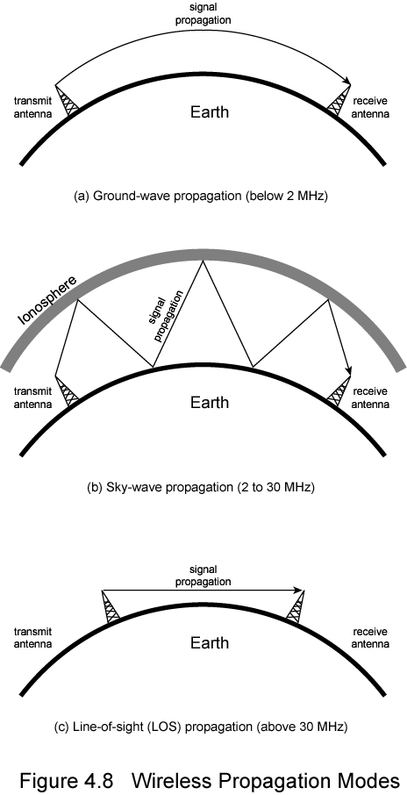
Ground Wave Propagation

Slide 49
Sky Wave Propagation

Slide 50
Line of Sight Propagation

Slide 51
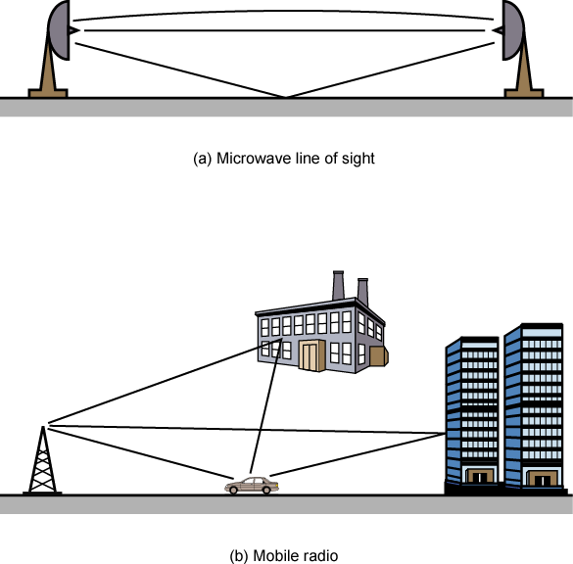
Multipath Interference

Slide 52
Summary
Transmission medium
  Guided
  Unguided

Slide 53
Reference
Data and Computer Communications, William Stallings

